Slide 1
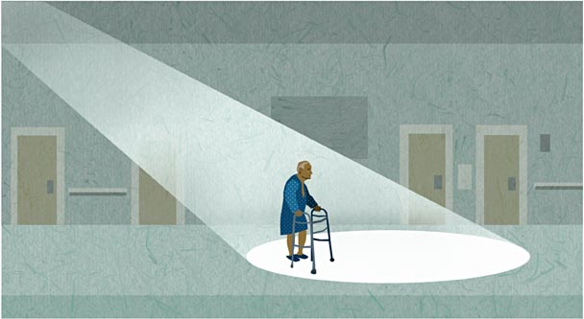
The Fall TIPS Program: Connecting Research to Evidence-Based Care
Patricia C. Dykes PhD, RN, FAAN

Slide 2
Overview
Describe the extent of the problem of patient falls
Discuss the components of an evidence-based fall prevention program using Fall TIPS as a model
Discuss roll-out of Fall TIPS
Patient Falls

Slide 3
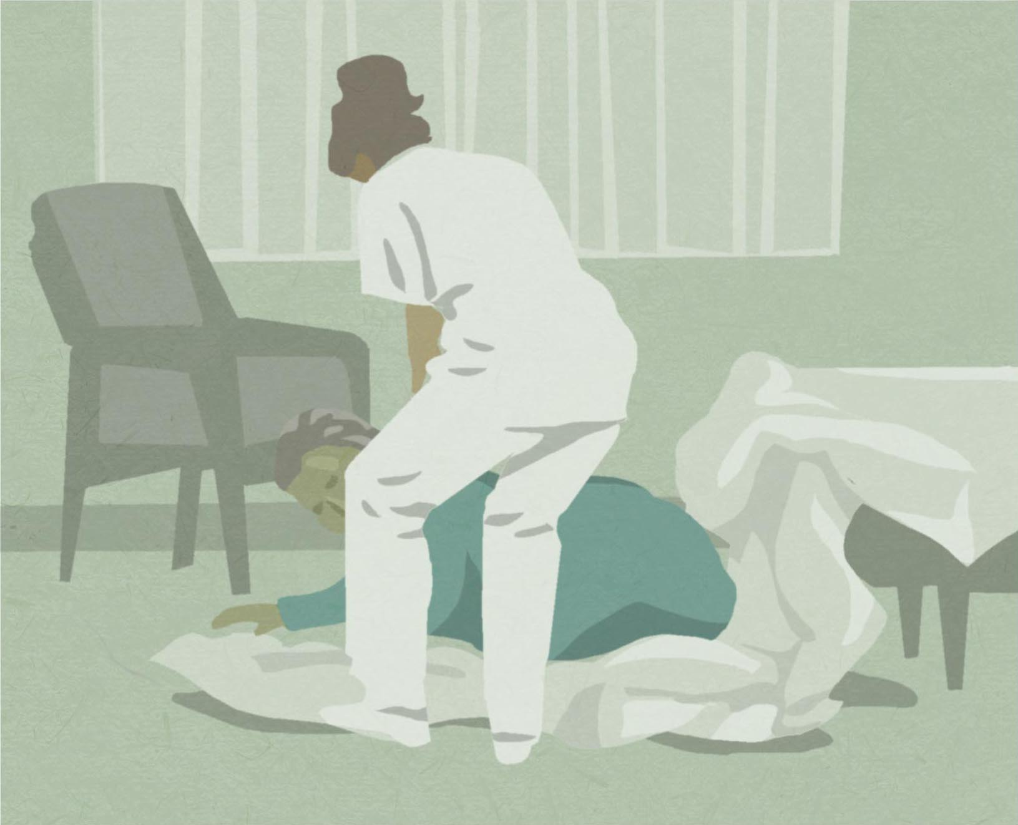
The Problem of Patient Falls
Falls are a leading cause of death and disability.
~ 33% of older adults fall each year
Hospitalization increases the risk for falls.
~ 3% hospitalized patients fall
~ 30% of inpatient falls result in injury
Patient falls and injurious falls are employed as national metrics for nursing care quality.
The incidence of patient falls and related injuries are publicly reported by acute care hospitals.
As of October 2008, costs associated with fall-related injuries in hospitals are no longer reimbursable under Medicare.

Slide 4
Fall Prevention in Acute Care Hospitals: The Evidence Circa 2007
Fall risk factors well established
Inpatient fall prevention research identified risk factors and fall risk assessment tool validation
Risk assessment insufficient for preventing falls
Paper-based fall prevention guidelines recommended multifaceted, tailored interventions
Insufficient evidence to support a specific protocol that links nursing fall risk assessment to a tailored plan to prevent falls.

Slide 5
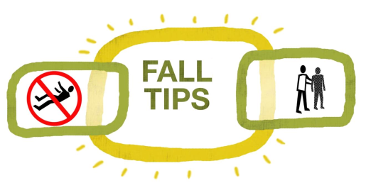
Example: Using the EHR for Fall Prevention Care Planning
Fall TIPS (Tailoring Interventions for Patient Safety)
2 year mixed methods study funded by Robert Wood Johnson Foundation:
Qualitative phase:
why hospitalized patients fall?
what interventions are effective and feasible in hospital settings?
Randomized control trial: to test an EHR-based fall prevention toolkit designed to address issues identified during qualitative phase.
Supported by the Robert Wood Johnson Foundation, Dykes PI

Slide 6
Fall TIPS (2007-2009): Qualitative Results Summary
Communication related to fall risk status and the plan to prevent falls is highly variable.
Inconsistent communication across team members is a barrier to fall prevention collaboration and teamwork.
Non-nursing team members do not view fall risk assessment/plan in medical record.
Inadequate, incomplete, or incorrect information at the bedside (i.e., generic “high risk for falls” signs are not useful).
All stakeholders (care team members, patients and family members) must work together to prevent patient falls.

Slide 7
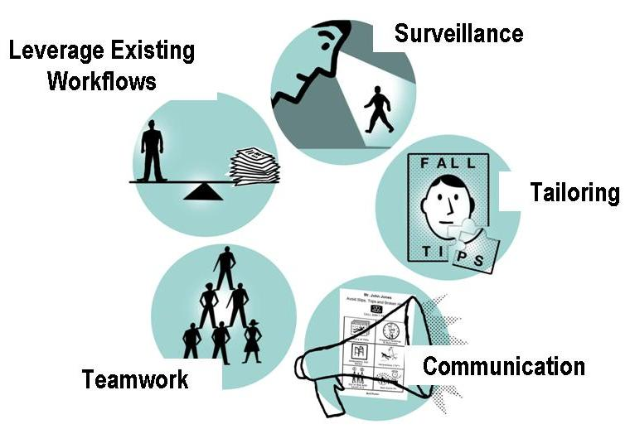
Fall TIPS (2007-2009): Toolkit Requirements

Slide 8
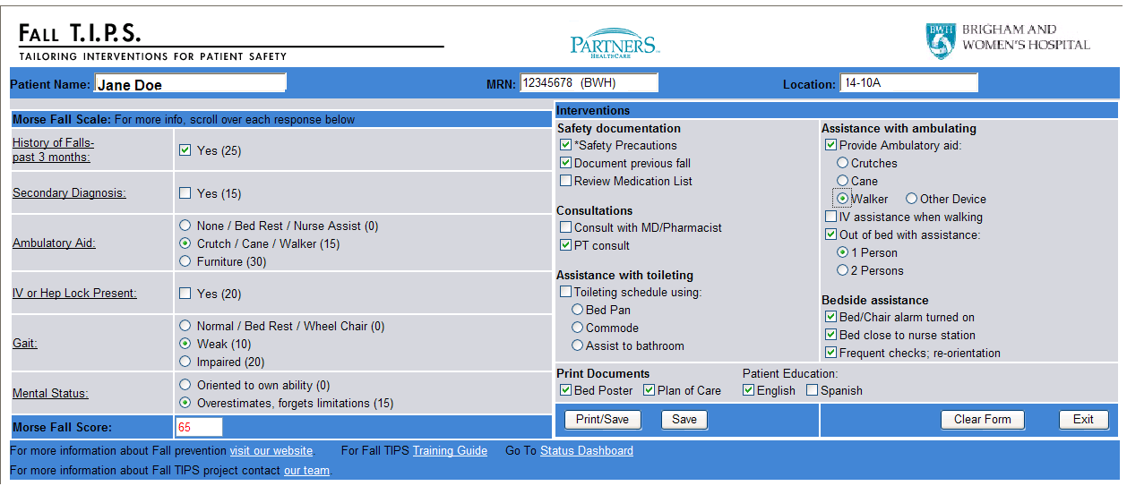
The Fall TIPS Toolkit:
Fall Risk Assessment/Tailored Plan
Fall risk assessment
Tailored plan
Notes:
8

Slide 9
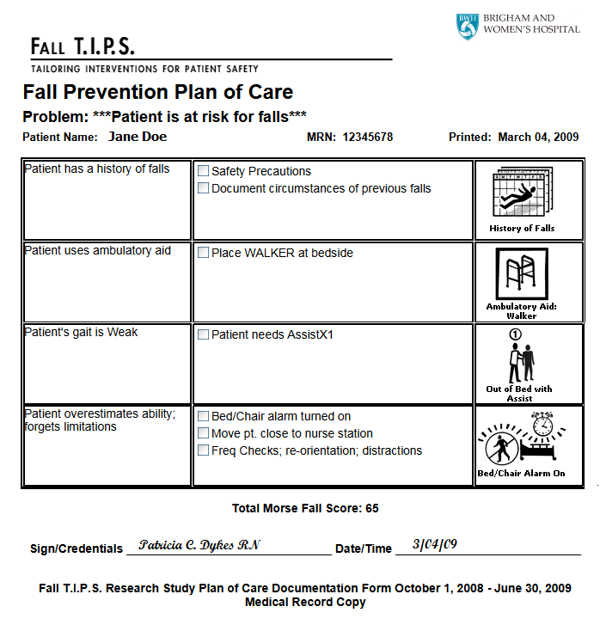
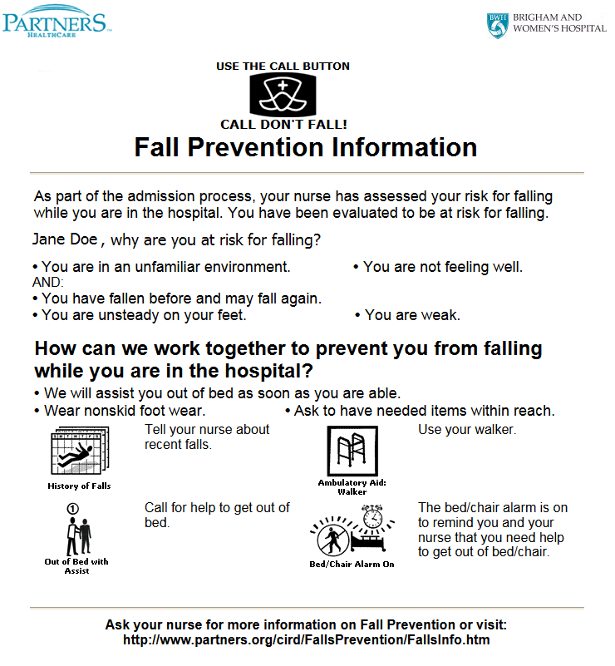
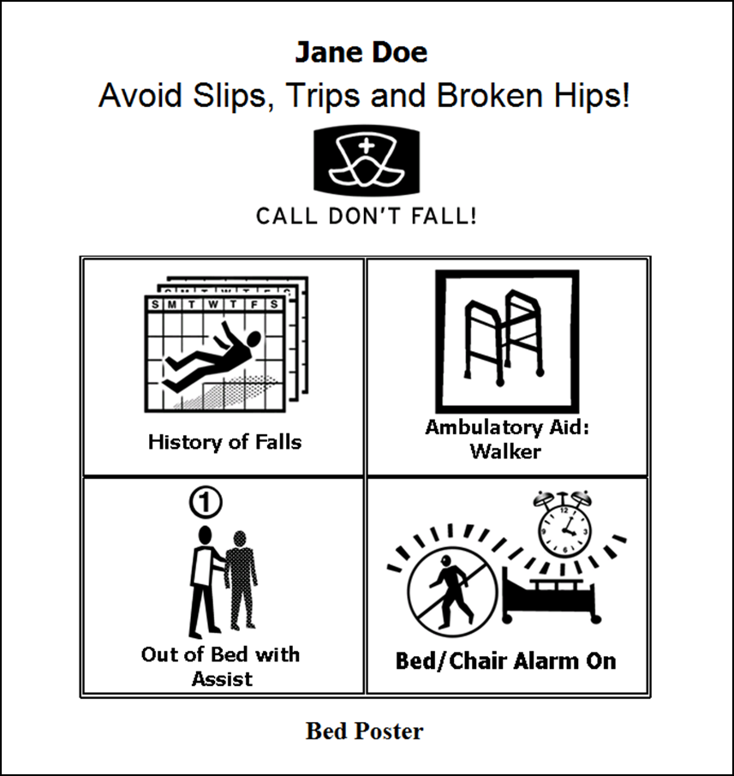
Bed Poster
Patient Education
Plan of Care
Notes:
9

Slide 10
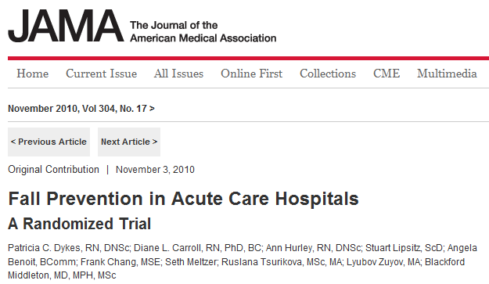
Fall TIPS: Findings
Patient falls were significantly reduced on intervention units
There were fewer falls in intervention units than in control units
Patients aged 65 or older benefited most from the Fall TIPS toolkit
No significant effect was noted in fall related injuries

Slide 11
Fall Prevention Lessons Learned
Fall prevention in hospitals is a 3-step process:
Conducting fall risk assessment using a prospectively validated tool.
Developing a plan of care that is tailored to patient-specific areas of risk.
Implementing the plan CONSISTENTLY.
Patient engagement is essential
Strategies and tools to facilitate the 3-step fall prevention process will prevent patients from falling!

Slide 12
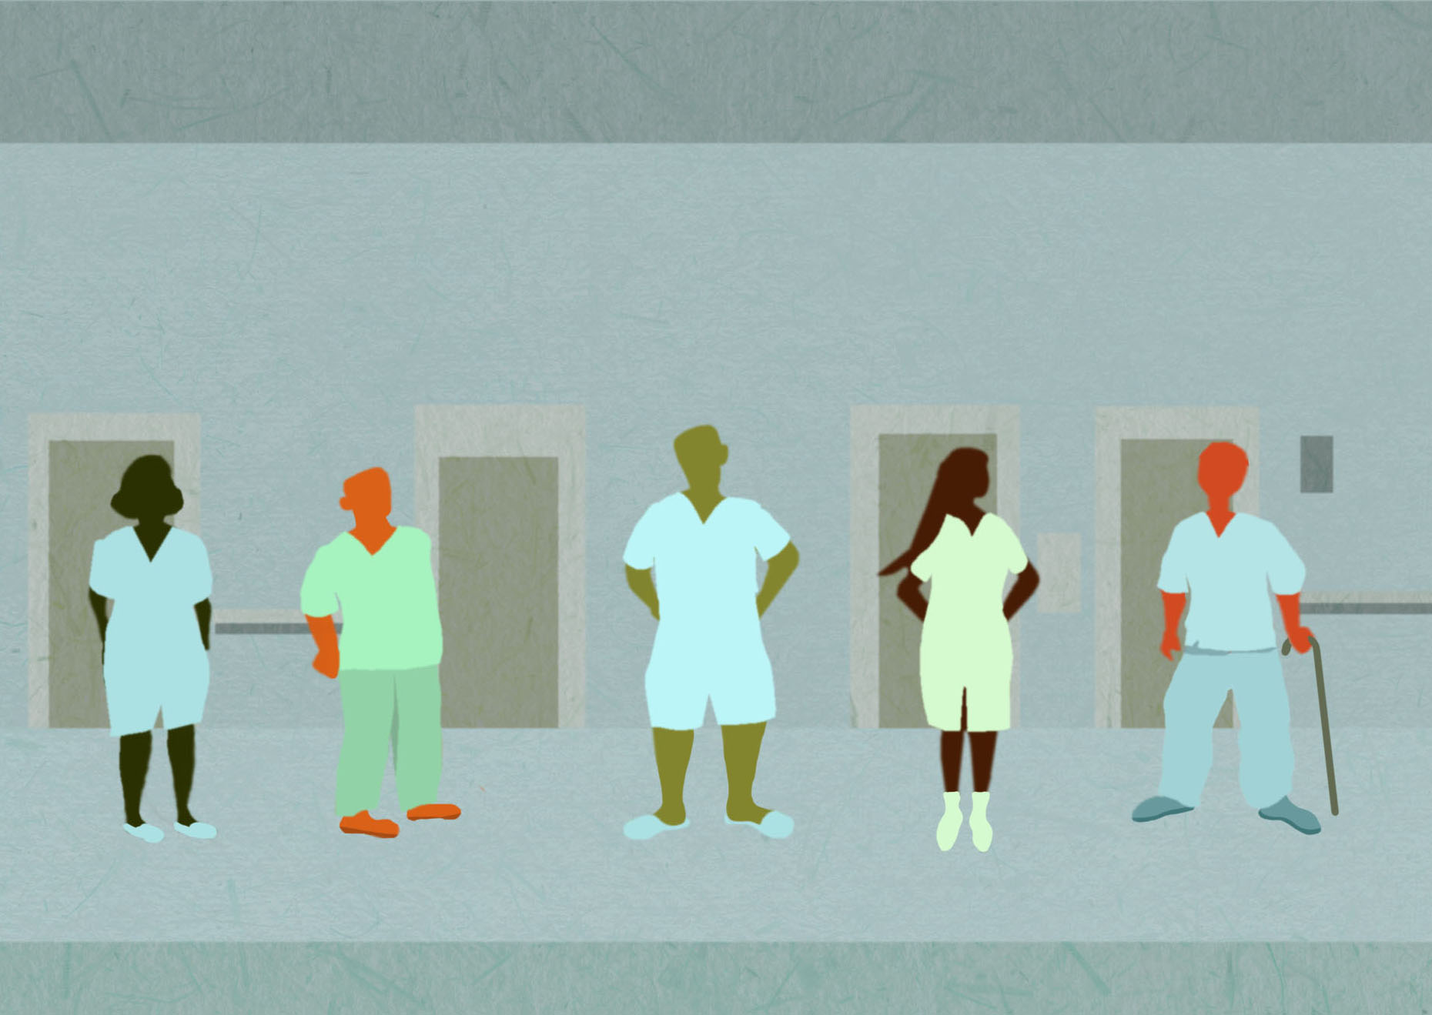
Fall TIPS Next Steps
Identify ways to disseminate Fall TIPS outside of the electronic health record.
Can be used in any hospital
Provides clinical decision support
Develop tools and strategies to engage patients and families in the 3-step fall prevention process.

Slide 13
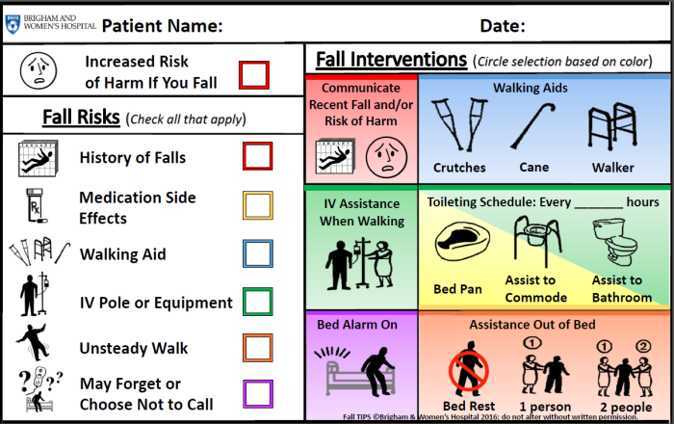
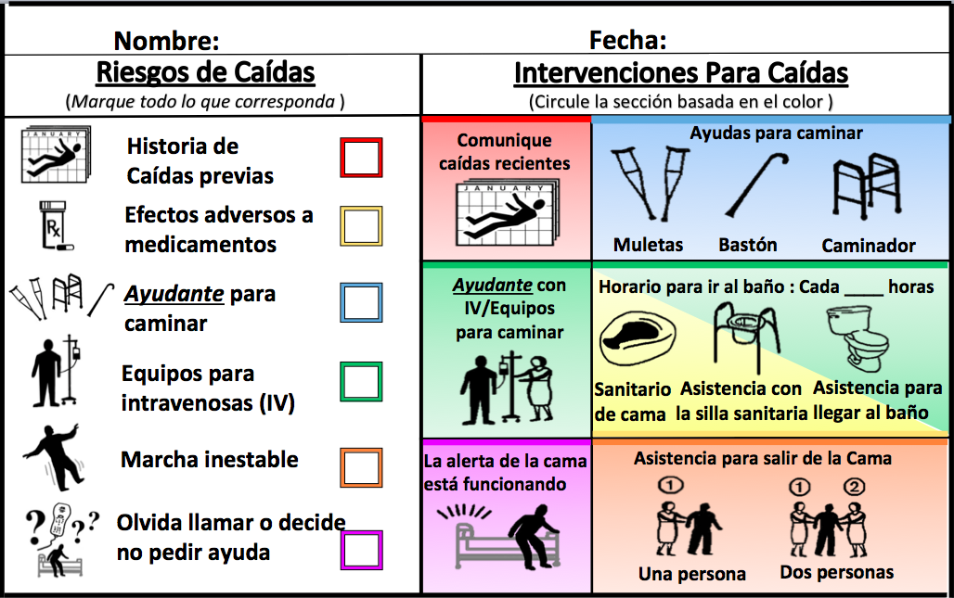
Laminated Paper Fall T.I.P.S.
Fall risk assessment
Tailored plan based on patient’s determinants of risk

Slide 14
Fall TIPS Pilot Test Results: BWH
Fall TIPS Adherence: 82%
Pre-Fall TIPS Fall Rate: 3.28
Post Fall TIPS Fall Rate: 2.80
Pre-Fall TIPS Injury Rate: 1.00
Post Fall TIPS Injury Rate: .54

Slide 15
Fall TIPS Pilot Test Results: MMC
Fall TIPS Adherence: 91%
Pre-Fall TIPS Fall Rate: 3.04
Post Fall TIPS Fall Rate: 3.10
Pre-Fall TIPS Injury Rate: .47
Post Fall TIPS Injury Rate: .31

Slide 16
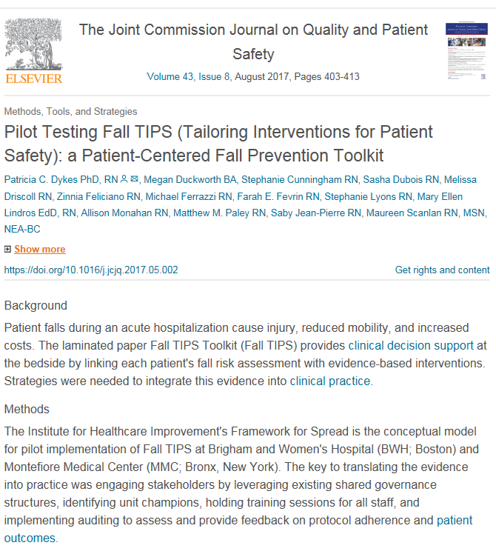

Slide 17
Fall Prevention in Acute Care Hospitals: The Evidence Circa 2018
Patient falls are a common problem and can be prevented using the 3-step fall prevention process.
EHR clinical decision support can link patient-specific risk factors to interventions most likely to prevent a fall.
Tools are available for use in clinical care to integrate the 3-step fall prevention process into the workflow.
Engaging patients and family in the 3-step fall prevention process ensures that they understand their risk factors and can play a role in ensuring that the fall prevention plan is implemented consistently.

Slide 18
Thank You: BWH/NEU Patient Safety Learning Lab Team
Brigham and Women’s Hospital
David Bates
Alex Businger
Sarah Collins
Brittany Couture
Anuj Dalal
Patricia Dykes
Sarah Khorasani
Lisa Lehmann
Emily Leung
Stuart Lipsitz
Eli Mlaver
Ronen Rozenblum
Jeffrey Schnipper
Kumiko Schnock
Partners HealthCare
Frank Chang
Ramesh Bapanapalli
Mohan Babu Ganasekaran
Gennady Gorbovitsky
James Benneyan
Corey Balint
Jennifer Coppola
Nicholas Fasano
Zachary Katsulis
Meredith Clemmens
Lindsey Baldo
Awatef Ergai
Dominic Breuer
Jillian Hines
Jessica Cleveland
Northeastern Institute of Healthcare Systems Engineering
Patient-centered Fall Prevention
Patricia Dykes
Megan Duckworth
Srijesa Khasnabish
Emily Leung
Awatef Ergai Jillian Hines
Zachary Katsulis
Ramesh Bapanapalli
Mohan Babu Ganasekaran
Jason Adelman
Maureen Scanlan
Notes:
Add Srijesa

Slide 19
Components of an Evidence-based Fall Prevention Program

Slide 20
Components of an Evidence-based Fall Prevention Program
Universal fall precautions
3-Step Fall Prevention Process:
Fall risk assessment
Tailored fall prevention care planning
Consistent implementation of the tailored care plan
Post fall management strategy
Implementation strategies
Unit-based champions
Competency
Continuous quality improvement strategies
Peer coaching

Slide 21
Types of falls
Evidence-based Fall Prevention

Slide 22
Types of Falls and How to Prevent Them
Accidental falls:
Occur in those who have no risks for falling
Usually caused by environmental hazard/error in judgment
14% of falls
Prevented through universal fall precautions
Source: Morse, J.M. (2009). Preventing patient falls. (2nd ed). New York: Springer. Published, 2009.

Slide 23
Types of Falls, cont.
Anticipated physiological falls:
Occur in those who have risk for falling
MFS includes 6 items that can predict this type of fall.
78% of falls
Prevented through fall risk assessment using validated tool and tailored care planning/
interventions
Source: Morse, J.M. (2009). Preventing patient falls. (2nd ed). New York: Springer. Published, 2009.

Slide 24
Types of Falls, cont.
Unanticipated physiological falls:
Occur in those who have no risks for falling
Caused by physiologic changes
Such as seizure
8% of falls
Most difficult to prevent. Some may not be preventable.
Source: Morse, J.M. (2009). Preventing patient falls. (2nd ed). New York: Springer. Published, 2009.

Slide 25
Evidence-based Fall Prevention Strategies
Universal Fall Precautions
3-Step Fall Prevention Process
Fall risk assessment (FRA)
Tailored fall prevention care planning
Consistent implementation of the tailored care plan
Post fall management

Slide 26
Universal Fall Precautions
Cornerstone of any hospital fall prevention program
Train all hospital staff who interact with patients.
Apply to all patients at all times
Clear pathways.
Wipe up spills immediately.
Provide access to call bell.
Provide non-skid footwear.
Creates hospital culture that values fall prevention

Slide 27
3-Step Fall Prevention Process
Conducting fall risk assessment
Completing tailored fall prevention care planning
Consistently implementing the plan

Slide 28
Step 1- Fall Risk Assessment
Step 1
Identifies patients at risk for falling
Provides baseline measure of patient-specific areas of risk
Aids in clinical decision making
Informs tailored or personalized preventative measures, care plans, and communication strategies
Standardized fall risk assessment is prerequisite to implementing evidence-based fall prevention intervention protocol.

Slide 29
Completion of the MFS
Step 1
MFS requires a chart review and direct observation of the patient
MFS should be completed at least once per shift
Scores may fluctuate from daytime to night time
Completion of the MFS requires training
MFS requires competency assessment

Slide 30
Risk Factors for Falls Identified by Morse Fall Scale
Step 1
History of falling
Secondary diagnosis
Associated with incontinence, vision problems, multiple medicines, orthostatic hypotension
Ambulatory aid
IV therapy/heparin (saline) lock
Gait
Mental status
Areas of Risk | Numeric Values
1. History of falling | No 0 Yes 25
2. Secondary diagnosis | No 0 Yes 15
3. Ambulatory aid None/bed rest/nurse assist Crutches/cane/walker Furniture | 0 15 30
IV or IV access | No 0 Yes 20
5. Gait Normal/bed rest/ wheelchair Weak Impaired | 0 10 20
6. Mental status Oriented to own ability Overestimates or forgets limits | 0 15
Source: Morse, JM. Predicting Patient Falls. CA: Sage Publications, 1997.
Notes:
Saby will start here

Slide 31
Risk 1: History of Falling
Step 1 + 2
Score 0 if none of the following are true:
Patient has fallen during this hospitalization.
Patient has immediate history of falls within the past 3 months. This is the most significant indicator for falling.
Score 25 if one or more of the above are true.
History of Falls | No | 0
 | Yes | 25
Interventions:
Use safety precautions.
Communicate risk status via plan of care, change of shift report, and signage.
Document circumstances of previous fall.

Slide 32
Risk 2: Secondary Diagnosis
Step 1 + 2
Score 0 if only 1 active medical diagnosis.
Score 15 if more than 1 medical diagnosis is active for current admission.
Think about factors that may increase risk for falls that are related to multiple medical problems:
Illness/multiple medications
Side effects such as dizziness, frequent urination, and unsteadiness
Vision problems
Interventions:
Consider implementing a toileting and rounding schedule
Review medication list
Secondary Diagnosis | No | 0
 | Yes | 15
Patients with multiple medical diagnoses are often on multiple medications. Along with the physical symptoms from the secondary diagnoses, this increases their risk for falls.

Slide 33
Risk 3: Ambulatory Aid
Step 1 + 2
Score 0 if patient walks without a walking aid or uses a wheelchair or is on bed rest and does not get up at all.
Score 15 if patient uses crutches or a walker.
Score 30 if the patient walks clutching onto furniture for support (e.g., needs help, but does not ask or does not comply with order for bed rest or to use an ambulatory aid).
Ambulatory Aid | None/ bed rest/ nurse assist | 0
 | Crutches/ cane/walker | 15
 | Furniture | 30
Interventions:
Use ambulatory aid at bedside if needed.
Review dangers of using furniture or hospital equipment as an ambulatory aid.
Assess ability to use ambulatory aid.
Consider PT consult.

Slide 34
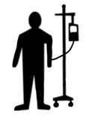
Risk 4: Intravenous/Heparin (Saline) Lock
Step 1 + 2
Score 0 if the patient does not have an IV, heparin (saline) lock.
Score 20 if the patient has an IV, heparin (saline) lock.
IV/Heparin (Saline) Lock | No | 0
 | Yes | 20
Interventions:
Implement toileting/rounding schedule.
Tell patient to call for help with toileting.
Review side effects of IV medications.

Slide 35
Risk 5: Gait
Step 1 + 2
Score 0 if the patient has a normal gait.
Walks with head erect. Arms swinging freely at the side. Striding without hesitation.
Score 10 if the patient has a weak gait.
Stooped, but able to lift head without losing balance. If furniture required, uses as a guide (feather-weight touch). Short steps, may shuffle.
Score 20 if the patient has an impaired gait.
Difficulty rising from chair (needs to use arms; several attempts to rise). Head down; watches ground while walking. Cannot walk without assist; grabs at furniture or whatever available. Short, shuffling gait.
Wheelchair: score according to gait used at transfer.
Interventions:
Help patient get out of bed.
Consider PT consult.
Gait | Normal | 0
 | Weak | 10
 | Impaired | 20
Assess your patient’s gait while they are walking with their ambulatory aid

Slide 36
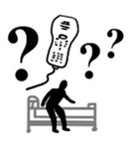
Risk 6: Mental Status
Step 1 + 2
To test mental status: Ask the patient, “Are you able to go to the bathroom alone or do you need assistance?”
Normal: patient response is consistent with orders or kardex.
Overestimates/forgets limitations: patient response is inconsistent with ambulation order or unrealistic.
Score 0 if the patient’s mental status is normal.
Score 15 if the patient is considered to overestimate his/her abilities or is forgetful of limitations.
Mental Status | Normal | 0
 | Forgets or overestimates | 15
Interventions:
Use bed/chair alarm or virtual monitoring.
Place patient in visible location.
Encourage family presence.
Do frequent rounding.

Slide 37
ABCs of Harm
Step 1 + 2
Patient is at high risk for injury if they fall with:
Age: 85 years old or older, frailty
Bones: osteoporosis, risk or history of fracture, etc
Coagulation: risk for bleeding, low platelet counts, or taking anticoagulation
Surgery (recent): lower limb amputation, major abdominal or thoracic surgery
Interventions:
Communicate that the patient is at an increased risk for injury if they fall.
Emphasize the importance of following their personalized fall prevention plan.
Notes:
Kasey

Slide 38
3-Step Fall Prevention Process
Step 2
Conducting fall risk assessment
Completing tailored fall prevention care planning
Consistently implementing the plan

Slide 39
Step 2- Tailored Fall Prevention Care Planning
Step 2
Review areas of risk identified by Morse Fall Scale for specific patient.
Select interventions to address each area of risk.
Communicate tailored fall prevention plan to all staff who interact with patient. Also share it with patient and their family members.

Slide 40
3-Step Fall Prevention Process
Conducting fall risk assessment
Completing tailored fall prevention care planning
Consistently implementing the plan
Carry out the plan consistently to prevent falls– patient engagement can help!

Slide 41
Step 3- Consistently Implementing the Plan
Step 3
Patient engagement
Engaging patients and family in the 3-step fall prevention process ensures that they understand their risk factors and can play a role in making sure that the fall prevention plan is implemented consistently.
Conduct the fall risk assessment with the patient then develop the tailored prevention plan together based on the risk factors identified.
Consistently educate and remind the patient how to implement the plan.
Notes:
Kasey

Slide 42
Tools to Support Fall TIPS Rollout Available on “resources” page at www.falltips.org/resources
Slides to Train Staff
1-page guides for RNs and Nursing Assistants
Fall TIPS email: PHSFallTIPS@partners.org

Slide 43
Fall TIPS Implementation Protocol Detailed Guide available at www.falltips.org/implement-fall-tips/step-1/
Secure Buy-In from Hospital Leadership
Secure Buy-In from Nurses
Recruit champions (for peer support/training, data collection)
Train Champions
Conduct fall risk assessment competency training with all staff using provided toolkit
Plan Implementation
Print, laminate paper Fall TIPS
Use “Readiness for Implementation Checklist”
Select Go-Live Date
Communicate Consistently
Track progress weekly
How often is Fall TIPS tool completed? (within 24 hours of admission and updated at least once a day)
How accurate and up-to-date is the tool?
How many days since last fall?
Provide continuous feedback
Via emails and posters
In-person rounding on nurses
Promote patient engagement and education

Slide 44
3-step fall prevention process case study
Evidence-based Fall Prevention

Slide 45
Case 1: John
John, an 82-year-old man with diabetes was admitted to BWH medical unit with chest pain and shortness of breath. On admission, the patient was found to be alert and oriented. He had an IV and was placed on a cardiac monitor.
During the admission interview, John reported that with his cane, he was independent with walking and transfers. However, the nurse noted that the doctor’s order was for walking with cane and assistance only.
With further questioning, the patient reported that he had fallen at home several times over the past year, most recently last month.
As the nurse assisted the patient to the bathroom, she noted that initially he used the bedside table and other furniture as guides and needed to be reminded to use his cane.
Once he was given a cane, John walked with short, steady steps to the bathroom.

Slide 46
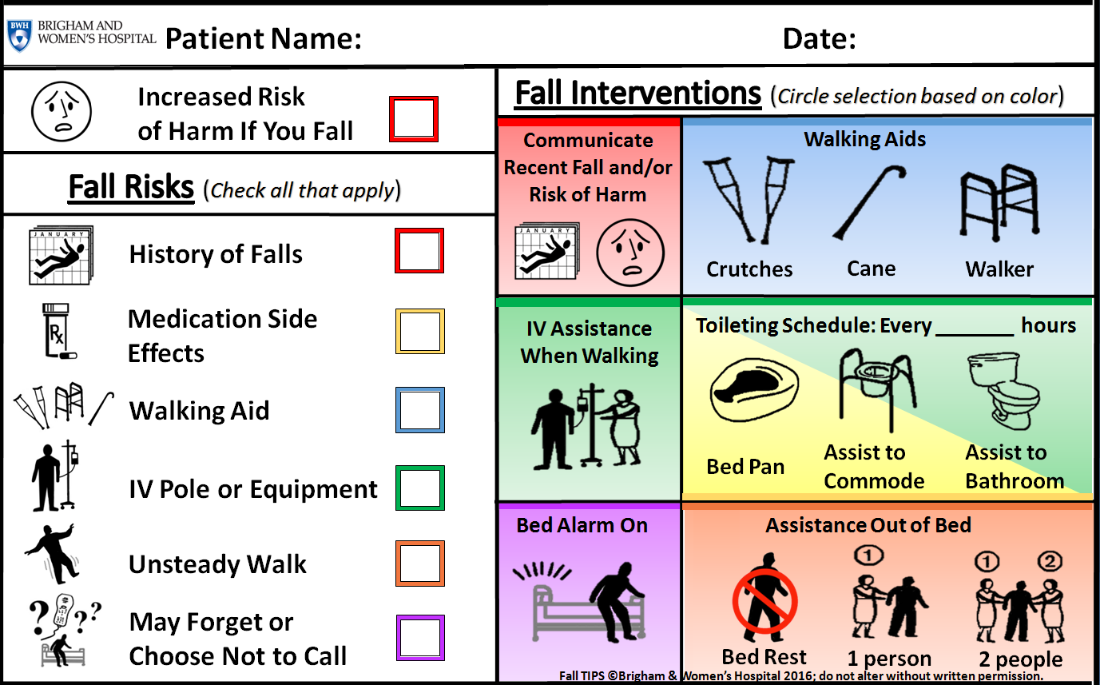
Paper Fall TIPS Tool

Slide 47
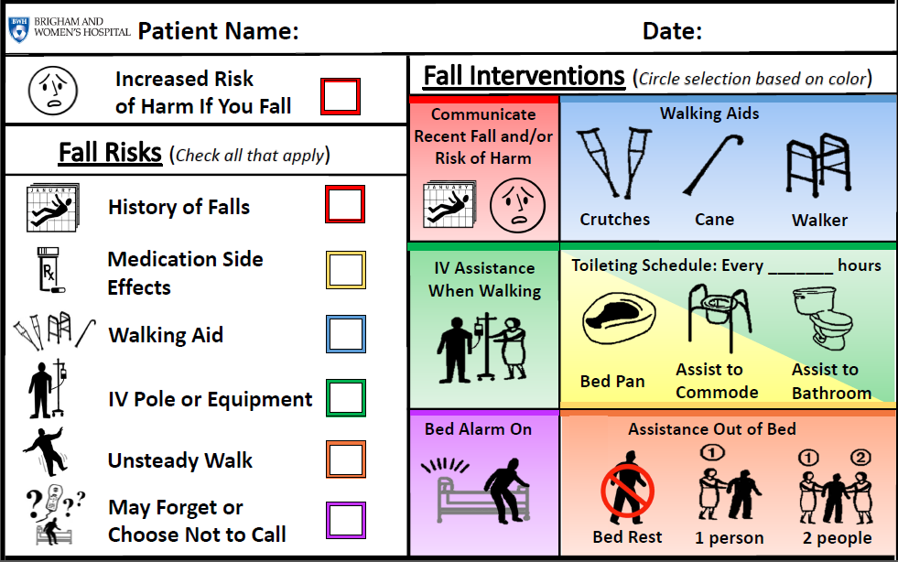
Answers
John 05/12/2016


1





Slide 48
Evidence-based Fall Prevention Recap
Most patient falls are preventable
An evidence-based fall prevention program includes the following components:
Standard definitions
Universal fall precautions
3-Step Fall Prevention Process:
Fall risk assessment
Tailored fall prevention care planning
Consistent implementation of the tailored care plan
Post fall management
Implementation requires a continuous quality improvement, interdisciplinary, team-based approach

Slide 49
The Fall TIPS Collaborative: A Partnership for Spread
Benefits of Membership:
Ongoing access to the Fall TIPS Toolkit, Fall TIPS training webinars, and the implementation guides
Interested in joining? Sign up at www.falltips.org/fall-tips-collaborative/

Slide 50
Thank You!

